Slide 1
Pushing to the Top with K-induction
Arie Gurfinkel
Electrical and Computer Engineering
University of Waterloo
joint work with Alexander Ivrii (IBM)

Slide 2
Agenda
IC3 is one of the most powerful algorithms for model checking safety properties
Very active area of research:
A. Bradley: SAT-Based Model Checking Without Unrolling. VMCAI 2011 (IC3 stands for “Incremental Construction of Inductive Clauses for Indubitable Correctness”)
N. Eén, A. Mishchenko, R. Brayton: Efficient implementation of property directed reachability. FMCAD 2011 (PDR stands for “Property Directed Reachability”)
…
In this talk, I present a new IC3-based algorithm, called QUIP (QUIP stands for “a QUest for an Inductive Proof”)
and show how QUIP can be extended with k-induction
Notes:
This formulation allows to easily reuse invariants between targets, problems; treat multiple targets “concurrently”, and so on…

Slide 3
A brief preview of Quip
Quip extends IC3 by allowing for
A wider range of conjectures (proof obligations)
Designed to push already existing lemmas more aggressively
Allows to push a given lemma by learning additional supporting lemmas (and hopefully to compute an inductive invariant faster)
Forward reachable states
Explain why a lemma cannot be pushed
Allows to keep the number of proof obligations under control
These are integrated into a single algorithmic procedure
The experimental results look good
Notes:
This formulation allows to easily reuse invariants between targets, problems; treat multiple targets “concurrently”, and so on…

Slide 4
Problem: Symbolic Safety and Reachability
A transition system P = (V, Init, Tr, Bad)
P is UNSAFE if and only if there exists a number N s.t.
P is SAFE if and only if there exists a safe inductive invariant Inv s.t.
Inductive
Safe

Slide 5

Inductive Invariants
System State Space
Inv
Bad
Initial
System S is safe iff there exists an inductive invariant Inv:
Initiation: Initial $⊆$ Inv
Safety: Inv $∩$ Bad = $∅$
Consecution: TR(Inv) $⊆$ Inv
i.e., if s $∈$ Inv and s$↝$t then t $∈$ Inv

Slide 6
Inductive Invariants
System State Space
Inv
Bad
Reach
Initial
System S is safe iff there exists an inductive invariant Inv:
Initiation: Initial $⊆$ Inv
Safety: Inv $∩$ Bad = $∅$
Consecution: TR(Inv) $⊆$ Inv
i.e., if s $∈$ Inv and s$↝$t then t $∈$ Inv
System S is safe if Reach $∩$ Bad = $∅$

Slide 7

Generalizing from Bounded Proofs
T, N=0
A counterexample of length N exists?
Yes
No, N:=N+1
SAT
Is a safe inductive invariant?
YES
No + bounded proof
SAT
Generalize proof
candidate Inv
SAT

Slide 8
IC3/PDR
F = [Init]
MkSafe
CEX
PDR trace
G = [G₀, …, G_{N}]
Push
F = [F₀, …, F_{N}]
F = [F₀, …, F_{N}]
No
∃ i, F_{i} = F_{i+1}
Yes
SAFE

Slide 9
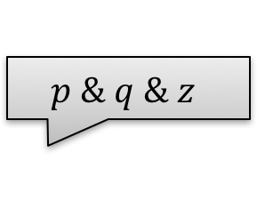
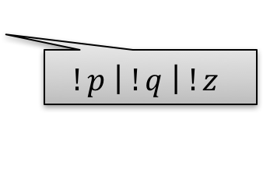

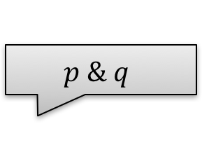
IC3/PDR In Pictures: MkSafe
MkSafe
$$p \& q \& z$$
$$p \& q$$
$$!p$$
$$!p \left| !q \right| !z$$
F₂
F₃
F₁
F₀

Slide 10
IC3/PDR in Pictures: Push
Push
Inductive
Algorithm Invariants
F_{i} → : Bad Init → F_{i}
F_{i} → F_{i+1} F_{i} ∧ Tr → F’_{i+1}

Slide 11
A quick review of IC3/PDR
Input:
A safety verification problem (Init, Tr, Bad)
Output:
A counterexample (if the problem is UNSAFE),
A safe inductive invariant (if the problem is SAFE)
Resource Limit
Main Data-structures:
A current working level N
An inductive trace
A set of proof obligations
Notes:
This formulation allows to easily reuse invariants between targets, problems; treat multiple targets “concurrently”, and so on…

Slide 12
Inductive Trace
Let F₀, F₁, F₂, …, F∞ be conjunctions of lemmas (in practice, clauses). We say that F₀, F₁, F₂, …, F∞ is an inductive trace if:
F₀ = INIT
F₀ ⇒ F₁ ⇒ F₂ ⇒ … ⇒ F∞ (monotone)
F₁ ⊇ F₂ ⊇ … ⊇ F∞ as sets of lemmas (s. monotone)
F_{i} ∧ TR ⇒ F_{i+1}’ for i ≥ 0 (including F∞ ∧ Tr ⇒ F∞’). (inductive)
Remarks:
This definition is slightly different from the original definition:
the sequence F₀, F₁, F₂, … is conceptually infinite (with F_{i} = T for all sufficiently large i )
we add F∞ as the last element of the trace (as suggested in PDR)
Each F_{i} over-approximates states that are reachable in i steps or less (in particular, F∞ contains all reachable states)
Notes:
This formulation allows to easily reuse invariants between targets, problems; treat multiple targets “concurrently”, and so on…

Slide 13
Safe Monotone Inductive Trace
P
F_{j}
R_{j}
F_{j-1}
F₂
F₁
R_{j-1}
R₁
R₂
……
Init
Bad =¬p
F_{i} over-approximates the states that are reachable in at most i steps
If F_{j+1} ⇒ F_{j} then F_{j} is an inductive invariant

Slide 14
Proof Obligations in IC3
A proof obligation in IC3 is a pair (s, i), where
s is a (generalized) cube over state variables
i is a natural number (called level)
We say that (s, i) is blocked (or that s is blocked at level i) if F_{i} ⇒ ¬s.
Given a proof obligation (s, i), IC3 attempts to strengthen the inductive trace in order to block it.
Remarks:
In IC3, s is identified with a counterexample-to-induction (CTI)
If (s, i) is a proof obligation and i≥1, then (s, i-1) is already blocked
All proof obligations are managed via a priority queue:
Proof obligations with smallest level are considered first
(additional criteria for tie-breaking)
Notes:
This formulation allows to easily reuse invariants between targets, problems; treat multiple targets “concurrently”, and so on…

Slide 15
Recursive Blocking Stage in IC3
// Find a counterexample, or strengthen the inductive trace
// s.t. F_{N} ⇒ ¬s holds
IC3_recBlockCube(s, N)
Add(Q, (s, N))
while ¬Empty(Q) do
(s, k) ← Pop(Q)
if (k = 0) return “Counterexample”
if (F_{k} ⇒ ¬s) continue
if (F_{k-1} ∧ Tr ∧ s’) is SAT
t ← generalized predecessor of s
Add(Q, (t, k-1)) Add(Q, (s, k))
else ¬t ← generalize ¬s by inductive generalization (to level m≥k)
add ¬t to F_{m}
if (m<N) Add(Q, (s, m+1))
Notes:
This formulation allows to easily reuse invariants between targets, problems; treat multiple targets “concurrently”, and so on…

Slide 16
Pushing stage in IC3
// Push each clause to the highest possible frame up to N
IC3_Push()
for k = 1 .. N-1 do
for c ∈ F_{k} \ F_{k+1} do
if (F_{k} ∧ Tr ⇒ c’)
add c to F_{k+1}
if (F_{k} = F_{k+1})
return “Proof” // F_{k} is a safe inductive invariant
Notes:
This formulation allows to easily reuse invariants between targets, problems; treat multiple targets “concurrently”, and so on…

Slide 17
Towards improving IC3 (1)
IC3 is an excellent algorithm! So, what do we want?
We want more control on which lemmas to learn:
Each lemma in the inductive trace is neither an over-approximation nor an under-approximations of reachable states (a lemma in F_{k} only over-approximates states reachable within k steps):
IC3 may learn lemmas that are too weak (ex. C₁) – prune less states
IC3 may learn lemmas that are too strong (ex. C₂) – cannot be in the inductive invariant
C₁
Reach
Init
Bad
C₂
Notes:
This formulation allows to easily reuse invariants between targets, problems; treat multiple targets “concurrently”, and so on…

Slide 18
Towards improving IC3 (2)
We want to know if an already existing lemma is good (in F∞) or bad (e.g., C₂ from before):
Avoid periodically pushing bad lemmas
Ideally, we also want to prune less useful lemmas
We want to prioritize reusing already discovered lemmas over learning of new ones:
When the same cube s is blocked at different levels, usually different lemmas are discovered
Although, IC3 partially addresses this using pushing (and other optimizations)
Use the same lemma to block s (at the expense of deriving additional supporting lemmas)
Although, in general different lemmas are of different “quality” and having some choice may be beneficial
Notes:
This formulation allows to easily reuse invariants between targets, problems; treat multiple targets “concurrently”, and so on…

Slide 19
Immediate improvement: unlimited pushing
// Push each clause to the highest possible frame up to N
IC3_Push_Unlimited()
for k = 1 .. do
for c ∈ F_{k} \ F_{k+1} do
if (F_{k} ∧ Tr ⇒ c’)
add c to F_{k+1}
if (F_{k} = F_{k+1})
F∞ ← F_{k}
if (F∞ ⇒ ¬Bad)
return “Proof” // F∞ is a safe inductive invariant
Claim: after pushing F∞ represents a maximal inductive subset of all lemmas discovered so far
Remark: the idea to compute maximal inductive invariants is suggested in PDR but claimed to be ineffective. In our implementation, “unlimited pushing” leads to ~10% overall speed up.
Notes:
This formulation allows to easily reuse invariants between targets, problems; treat multiple targets “concurrently”, and so on…

Slide 20
Pushing is Useful
Why pushing is useful:
During the execution of IC3, the sets F_{i} are incrementally strengthened, and so it may happen that F_{k} ∧ TR ⇒ c’, even though this was not true at the time that c was discovered
Why pushing is good:
By pushing c from F_{k} to F_{k+1}, we make F_{k} more inductive (and if F_{k} becomes equal to F_{k+1}, then F_{k} becomes an inductive invariant)
Suppose that c∈F_{k} blocks a proof obligation (s, k). By pushing c from F_{k} to F_{k+1}, we also block the proof obligation (s, k+1)
Pushing Clauses = Improving Convergence = Reusing old lemmas for blocking bad states
Notes:
This formulation allows to easily reuse invariants between targets, problems; treat multiple targets “concurrently”, and so on…

Slide 21
What Happens when Pushing Fails
Why pushing may fail: suppose that c ∈ F_{k} \ F_{k+1} but F_{k} ∧ TR does not imply c’. Why?
There are two alternatives:
c is a valid over-approximation of states reachable within k+1 steps, but F_{k} is not strong enough to imply this
We can strengthen the inductive trace so that F_{k} ∧ TR ⇒ c’ becomes true
c is NOT a valid over-approximation of states reachable within k+1 steps
There is a real forward reachable state r that is excluded by c
c has no chance to be in the safe inductive invariant
c is a bad lemma
A similar reasoning is used in:
Z. Hassan, A. Bradley, F. Somenzi: Better Generalization in IC3. FMCAD 2013
Notes:
This formulation allows to easily reuse invariants between targets, problems; treat multiple targets “concurrently”, and so on…

Slide 22
Two interdependent ideas
Prioritize pushing existing lemmas
Given a lemma c ∈ F_{k} \ F_{k+1}, we can add (¬c, k+1) as a may-proof-obligation
May-proof-obligations are “nice to block”, but do not need to be blocked
If (¬c, k+1) can be blocked, then c is pushed to F_{k+1}
If (¬c, k+1) cannot be blocked, then we discover a concrete reachable state r that is excluded by c and that explains why c cannot be inductive
Discover and use new forward reachable states
These are an under-approximation of forward reachable states
Given a reachable state, all the existing lemmas that exclude it are bad
Bad lemmas are never pushed
Reachable states may show that certain may-proof-obligations cannot be blocked
Reachable states may be used when generalizing lemmas
Conceptually, computing new reachable states can be thought of as new Init states
Notes:
This formulation allows to easily reuse invariants between targets, problems; treat multiple targets “concurrently”, and so on…

Slide 23
Quip
Input:
A safety verification problem (Init, Tr, Bad)
Output:
A counterexample (if the problem is UNSAFE),
A safe inductive invariant (if the problem is SAFE)
Resource Limit
Main Data-structures:
A current working level N
An inductive trace (same as IC3)
A set of proof obligations (similar to IC3)
A set R of forward reachable states
Notes:
This formulation allows to easily reuse invariants between targets, problems; treat multiple targets “concurrently”, and so on…

Slide 24
Proof Obligations in Quip
A proof obligation in Quip is a triple (s, i, p), where
s is a (generalized) cube over state variables
i is a natural number
p ∈ {may, must}
Remarks:
As in IC3, if (s, i, p) is a proof obligation and i≥1, then (s, i-1) is assumed to be already blocked
As in IC3, all proof obligations are managed via a priority queue:
Proof obligations with smallest level are considered first
In case of a tie, proof obligations with smallest number of literals are considered first
(additional criteria for tie-breaking)
Have a “parent map” from a proof obligation to its parent proof obligation
parent(t) = s if (t, k-1, q) is a predecessor of (s, k, p)
In fact, this is usually done in IC3 as well (for trace reconstruction)
Notes:
This formulation allows to easily reuse invariants between targets, problems; treat multiple targets “concurrently”, and so on…

Slide 25
Recursive Blocking Stage in Quip (1)
Each time that we examine a proof obligation (s, k, p), check whether s intersects a reachable state r∈R
Discover new reachable states when possible
Claim: if s intersects r∈R and if parent(s) exists, then there exists a reachable state r’ that intersects parent(s)
Indeed, ALL states in s lead to a state in parent(s)
Therefore r leads to a state in parent(s) as well
A similar idea is present in: C. Wu, C. Wu, C. Lai, C. Huang: A counterexample-guided interpolant generation algorithm for SAT-based model checking. TCAD 2014
When (s, k, p) is blocked by an inductive lemma ¬t, add (t, k+1, may) as a new proof obligation
Push ¬t to F_{k+1} instead of blocking (s, k+1)
Clear all proof obligations if their number becomes too large (important, not in pseudocode)
Notes:
This formulation allows to easily reuse invariants between targets, problems; treat multiple targets “concurrently”, and so on…

Slide 26
Recursive Blocking Stage in Quip (2)
// Find a reachable state r∈s, or strengthen the inductive trace s.t. F_{N} ⇒ ¬s
Quip_recBlockCube(s, N, q)
Add(Q, (s, N, q))
while ¬Empty(Q) do
(s, k, p) ← Pop(Q)
if (k = 0) && (p = must) return “Counterexample”
if (k = 0) && (p = may)
find a state r one-step-reachable from Init,
such that r intersects parent(s)
add r to R; continue
if (F_{k} ⇒ ¬s) continue
if (s intersects some state r∈R) && (p = must) return “Counterexample”
if (s intersects some state r∈R) && (p = may)
if parent(s) exists, find a state r’ one-step-reachable from r, such that r’ intersects parent(s) add r’ to R; continue
// -- continued on the next slide --
Notes:
This formulation allows to easily reuse invariants between targets, problems; treat multiple targets “concurrently”, and so on…

Slide 27
Recursive Blocking Stage in Quip (3)
Quip_recBlockCube(s, N, p)
// -- continued from the previous slide –-
if (F_{k-1} ∧ Tr ∧ s’) is SAT
t ← generalized predecessor of s
Add(Q, (t, k-1, p)) Add(Q, (s, k, p))
else ¬t ← generalize ¬s by inductive generalization (to level m≥k)
add ¬t to F_{m}
if (m<N)
if (t = s) Add(Q, (t, m+1, p))
else Add(Q, (t, m+1, may))
// attempt to block t (not s)
Notes:
This formulation allows to easily reuse invariants between targets, problems; treat multiple targets “concurrently”, and so on…

Slide 28
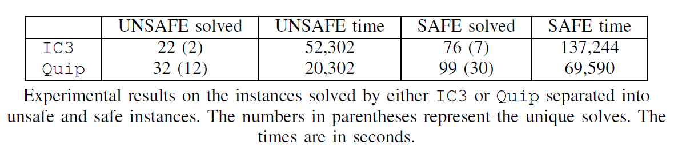
Experiments: IC3 vs. Quip on HWMCC’13 and ’14
Implemented in IBM formal verification tool Rulebase-Sixthsense
Data for 140 instances that were not trivially solved by preprocessing but could be solved either by IC3 or Quip within 1-hour
Detailed results at http://arieg.bitbucket.org/quip
Notes:
This formulation allows to easily reuse invariants between targets, problems; treat multiple targets “concurrently”, and so on…

Slide 29
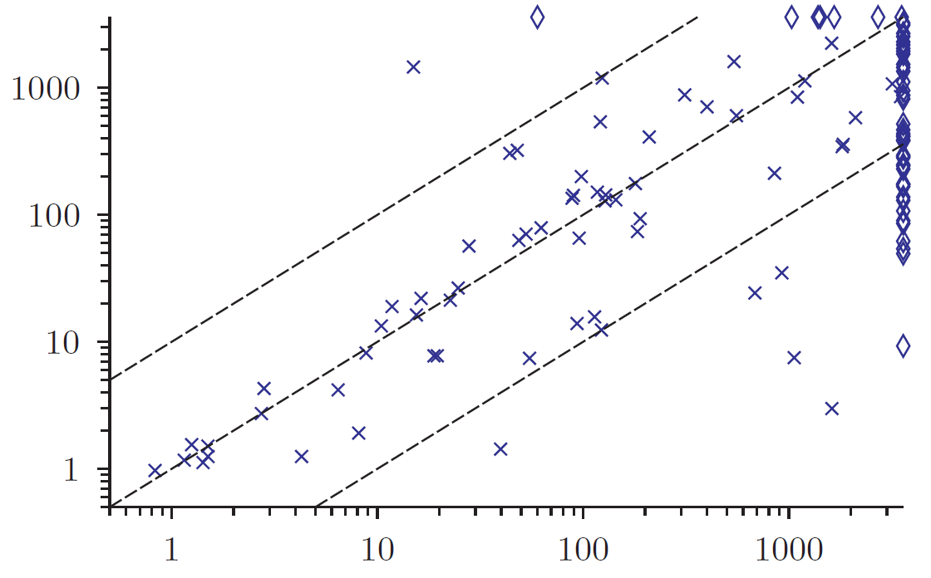
Experiments: IC3 vs. Quip on HWMCC’13 and ‘14
Data for 140 instances from prev slide
Quip (sec)
IC3 (sec)
Notes:
This formulation allows to easily reuse invariants between targets, problems; treat multiple targets “concurrently”, and so on…

Slide 30
Quip – future work
Improve handling of forward reachable states (both for performance and memory)
Generalize forward reachable states
Incorporate these ideas with other known IC3 developments
Abstraction-Refinement: Y. Vizel, O. Grumberg, S. Shoham: Lazy abstraction and SAT-based reachability in hardware model checking. FMCAD 2012
Lemma generalization: Z. Hassan, A. Bradley, F. Somenzi: Better Generalization in IC3. FMCAD 2013
Experiment with other ways to combine the ideas into a full algorithm
Lift Quip to more general domains
Notes:
This formulation allows to easily reuse invariants between targets, problems; treat multiple targets “concurrently”, and so on…

Slide 31
K-Induction without Unrolling FMCAD’17 Arie Gurfinkel Alexander Ivrii

Slide 32
K-induction Principle
[SSS2000]
Induction:
k-step Induction:
P(s₀)
∀i: P(s_{i}) ⇒ P(s_{i+1})
∀i: P(s_{i})
P(s_{0..k-1})
∀i: P(s_{i..i+k-1}) ⇒ P(s_{i+k})
∀i: P(s_{i})
Notes:
K-induction slides taken from http://www.eecs.berkeley.edu/~alanmi/courses/2005_290A/lectures/satlect05.ppt

Slide 33
SAT-based Model Checking with K-induction
Let the k-unrolling of transition relation be defined as:
U_{k} = T^{<0>} ∧ T^{<1>} ∧ ... ∧ T^{<k-1>}
Use SAT solver to check validity of two formulas:
Base case:
I^{<0>} ∧ U_{k-1} ⇒ P^{<0>}...P^{<k-1>}
Induction step:
U_{k} ∧ P^{<0>}...P^{<k-1>} ⇒ P^{<k>}
If both are valid, then P is true in all the reachable states
If the base case is invalid, there is a counterexample
If the induction step is invalid, increase k and try again

Slide 34
Simple path assumption
Unfortunately, k-induction is not complete
some properties are not k-inductive for any k
for example,
Simple path restriction:
There is a path to ¬P iff there is a simple path to ¬P (path with no repeated states)
P
P
¬P

Slide 35
Complete k-induction with simple paths
Let simple(s_{0..k}) be defined as:
∀i,j in 0..k : (i ≠ j) ⇒ s_{i} ≠ s_{j}
k-induction over simple paths:
P(s_{0..k-1})
∀i: simple(s_{0..k}) ∧ P(s_{i..i+k-1}) ⇒ P(s_{i+k})
∀i: P(s_{i})
Must hold for k large enough, since a length of the longest simple path is bounded (recurrence diameter)

Slide 36
Terminology: k-invariants and k-induction
ϕ is an invariant if it holds on all reachable states
ϕ is a k-invariant if it holds on all states reachable in up to k steps: Init(X₀) ∧ Tr(X₀, X₁) ∧ … ∧ Tr(X_{N-1}, X_{N}) ⇒ ϕ(X_{N}) for all 0 ≤ N ≤ k
ϕ is a k-inductive invariant if ϕ is a (k-1)-invariant, and ϕ(X₀) ∧ Tr(X₀, X₁) ∧ … ∧ ϕ(X_{k-1}) ∧ Tr(X_{k-1}, X_{k}) ⇒ ϕ(X_{k})
k-induction states that if ϕ is a k-inductive invariant, then ϕ is an invariant
Notes:
This formulation allows to easily reuse invariants between targets, problems; treat multiple targets “concurrently”, and so on…

Slide 37
k-induction vs IC3
k-induction and IC3 have complementary strengths, both theoretically and practically
Can we understand both algorithms in a common way?
we present an IC3-like algorithm to show whether a given safety property is k-inductive
Can we devise an effective algorithm combining the two?
we show how IC3 can be extended with k-inductive reasoning – with minor modifications of the IC3-algorithm
Notes:
This formulation allows to easily reuse invariants between targets, problems; treat multiple targets “concurrently”, and so on…

Slide 38
k-induction vs IC3
k-induction and IC3 algorithms are heavily used for unbounded model checking in both hardware and software domains
Theoretically, the two algorithms have complementary strengths:
k-induction (with loop-free constraints) is stronger than 1-induction
IC3 derives new lemmas to strengthen the property
Practically (on hardware benchmarks)
k-induction is mostly successful for small values of k (up to 10)
IC3 solves many more properties than k-induction
However, there are properties that can be proved by k-induction with low value of k, but IC3 “gets lost”
Notes:
This formulation allows to easily reuse invariants between targets, problems; treat multiple targets “concurrently”, and so on…

Slide 39
k-induction without unrolling
We present K-IND – an algorithm to decide whether a (k-1)-invariant formula ϕ is k-inductive
K-IND returns:
ϕ is k-inductive, OR
ϕ is not k-inductive (and a counterexample to k-induction)
Highlights:
Does not unroll the transition relation
Guarantees loop-free constraints without introducing expensive unique-state constraints
Notes:
This formulation allows to easily reuse invariants between targets, problems; treat multiple targets “concurrently”, and so on…

Slide 40
K-IND: for k=3 and without loop-free constraints
Let ϕ be 2-invariant
No Init-state can reach a ¬ϕ-state in 0, 1 or 2 steps
Taking 0, 1 or 2 successive predecessors of a ¬ϕ-state cannot get to an Init-state
We want to check/determine whether ϕ is 3-inductive invariant
ϕ(X₀) ∧ Tr(X₀, X₁) ∧ ϕ(X₁) ∧ Tr(X₁, X₂) ∧ ϕ(X₂) ∧ Tr(X₂, X₃) ⇒ ϕ(X₃) ?
Equivalently, we want to check whether the following formula is satisfiable
ϕ(X₀) ∧ Tr(X₀, X₁) ∧ ϕ(X₁) ∧ Tr(X₁, X₂) ∧ ϕ(X₂) ∧ Tr(X₂, X₃) ∧ ¬ϕ(X₃)
Equivalently, ϕ is a 3-inductive invariant if and only if we cannot start from a ¬ϕ-state and find 3 successive predecessors satisfying ϕ
Notes:
This formulation allows to easily reuse invariants between targets, problems; treat multiple targets “concurrently”, and so on…

Slide 41
K-IND: demonstration
We use an IC3-like algorithm to check satisfiability:
ϕ(X₀) ∧ Tr(X₀, X₁) ∧ ϕ(X₁) ∧ Tr(X₁, X₂) ∧ ϕ(X₂) ∧ Tr(X₂, X₃) ∧ ¬ϕ(X₃)
For simplicity, assume that ϕ = ¬s, where s is a cube over registers
t is a predecessor of s
u is a predecessor of t
v is a predecessor of u
We have found 3 successive predecessors: ϕ is not 3-inductive
Moreover, if v is an Init-state, then we have a counter-example to ϕ
v
u
t
s
ϕ ∧ Tr ∧ u’
ϕ ∧ Tr ∧ t’
ϕ ∧ Tr ∧ s’
Notes:
This formulation allows to easily reuse invariants between targets, problems; treat multiple targets “concurrently”, and so on…

Slide 42
K-IND: demonstration
We use an IC3-like algorithm to check satisfiability:
ϕ(X₀) ∧ Tr(X₀, X₁) ∧ ϕ(X₁) ∧ Tr(X₁, X₂) ∧ ϕ(X₂) ∧ Tr(X₂, X₃) ∧ ¬ϕ(X₃)
For simplicity, assume that ϕ = ¬s, where s is a cube over registers
Suppose now that t has no predecessors satisfying ϕ
As in IC3, we can learn a lemma ¬t that explains why t is not reachable
All SAT queries are made relative to the same frame
All lemmas “hold for all frames”
No need re-enqueue discharged proof obligations
t
s
ϕ ∧ Tr ∧ t’
ϕ ∧ Tr ∧ s’
Notes:
This formulation allows to easily reuse invariants between targets, problems; treat multiple targets “concurrently”, and so on…

Slide 43
K-IND: demonstration
Putting it all together:
Keep a stack of proof obligations {(s, i)}, initially {(¬ϕ, 0)}
Where i represents the “depth” rather than “level”
Keep a set of lemmas G, initially empty
Iteratively:
Take the top proof obligation t and make a predecessor query G ∧ ϕ ∧ Tr ∧ t’
If found a depth-3 predecessor u and u is Init, return “Counter-Example”
Else if found a depth-3 predecessor, return “Counter-Example to 2-induction”
Else if found a predecessor u, add a new proof obligation (u, i-1)
Else adds ¬t to G
If G ⇒ ¬s, return “Blocked”
As in IC3, we can generalize ¬t as long as Init⇒¬t and G ∧ ϕ ∧ Tr ∧ ¬t ⇒ ¬t’
in this case, the algorithm may return “Blocked” even when ϕ is not 3-inductive
But, G is still an inductive invariant proving ϕ
Notes:
This formulation allows to easily reuse invariants between targets, problems; treat multiple targets “concurrently”, and so on…

Slide 44
K-IND: loop-free constraints
To integrate simple-path constraints, add (the negations of) all parent states to the predecessor queries
Here s, t, u, v are generalized proof obligations (= sets of states)
v
u
t
s
¬u∧¬t∧¬s ∧ ϕ ∧ Tr ∧ u’
¬s ∧ ϕ ∧ Tr ∧ s’
¬t∧¬s ∧ ϕ ∧ Tr ∧ t’
Notes:
This formulation allows to easily reuse invariants between targets, problems; treat multiple targets “concurrently”, and so on…

Slide 45
K-IND: relatively k-inductive
Let F be 0-invariant (Init ⇒ F)
ϕ is a k-inductive invariant relative to F if ϕ is a k-invariant, and ϕ(X₀) ∧ F(X₀) ∧ Tr(X₀, X₁) ∧ … ∧ ϕ(X_{k-1}) ∧ F(X_{k-1}) ∧ Tr(X_{k-1}, X_{k}) ⇒ ϕ(X_{k})
K-IND can be extended to determine if ϕ is k-inductive relative to F
Notes:
This formulation allows to easily reuse invariants between targets, problems; treat multiple targets “concurrently”, and so on…

Slide 46
K-IND: experimental results
In practice (on hardware benchmarks, and without loop-free constraints):
K-IND solves a few more properties than k-induction
Due to lemma generalization
When solved by both, k-induction is usually faster than K-IND
Exactly in the same way as BMC is usually faster than IC3 when looking for counterexamples
Notes:
This formulation allows to easily reuse invariants between targets, problems; treat multiple targets “concurrently”, and so on…

Slide 47
KIC3: K-Inductive IC3
Related Work: PD-KIND
“Property-Directed k-Induction”, Dejan Jovanović and Bruno Dutertre, FMCAD’2016
Variant of IC3/PDR based on k-induction
Effective on SMT benchmarks
Requires unrolling transition relation for validating k-inductive queries
A direct implementation of PD-KIND for hardware does not scale
Has strongly inspired our solution
We present KIC3
A framework extending IC3 with k-inductive reasoning
Integrates k-induction into IC3 with minor modifications of the IC3-framework
But does not fully incorporate loop-free constraints
Notes:
This formulation allows to easily reuse invariants between targets, problems; treat multiple targets “concurrently”, and so on…

Slide 48
k-inductive blocking
Given a proof obligation (s, i), we can attempt to block s using k-induction relative to F_{i-1}
Can choose any k ≤ i
Let’s suppose that F_{i-1} ∧ ¬s ∧ Tr ∧ s’ is satisfiable, and t is a predecessor of s in F_{i-1}
IC3:
Adds a new proof obligation (t, i-1)
Proceeds to checking whether F_{i-2} ∧ ¬t ∧ Tr ∧ t’ is satisfiable
k-inductive blocking (for k > 1):
Adds a new proof obligation (t, i)
Proceeds to checking whether F_{i-1} ∧ ¬t ∧ Tr ∧ t’ is satisfiable
Notes:
This formulation allows to easily reuse invariants between targets, problems; treat multiple targets “concurrently”, and so on…

Slide 49
Comparison of KIC3-blocking and IC3-blocking
What happens if both F_{i-2} ∧ ¬t ∧ Tr ∧ t’ and F_{i-1} ∧ ¬t ∧ Tr ∧ t’ are UNSAT?
IC3 learns a lemma valid (at least) to F_{i-1}
k-inductive blocking learns a lemma valid (at least) to F_{i}
Lemmas learned by k-inductive blocking are in general of “higher quality”
What happens if F_{i-2} ∧ ¬t ∧ Tr ∧ t’ is UNSAT, while F_{i-1} ∧ ¬t ∧ Tr ∧ t’ is SAT?
IC3 stops blocking (t, i-1) and returns to blocking (s, i)
k-inductive blocking continues blocking predecessors of t
If k-inductive blocking succeeds blocking the topmost proof-obligation (s, i)
It may learn more lemmas, but all of these lemmas are valid (at least) to F_{i}
Recall that using k-induction to block (s, i) may return “counterexample-to-k-induction”
Simple solution: fall back to blocking (s, i) using IC3
Inspired by PD-KIND: block this counterexample-to-k-induction using IC3* and continue blocking (s, i) using k-induction
*or we can again use m-inductive blocking for a suitable value of m
Notes:
This formulation allows to easily reuse invariants between targets, problems; treat multiple targets “concurrently”, and so on…

Slide 50
Alternative ways to think about KIC3-blocking
k-inductive blocking is IC3 with a slightly different strategy for managing proof obligations
IC3 schedules proof obligations at the lowest level they are unknown
k-inductive blocking may schedule proof obligations to higher levels instead
k-inductive blocking can be thought of as abstraction
Given a proof obligation (t, j), IC3 checks whether ¬t is inductive relative to F_{j-1}
However, any abstraction of F_{j-1} can be used instead
For example, using only lemmas from F_{i-1} closely corresponds to KIC3
Notes:
This formulation allows to easily reuse invariants between targets, problems; treat multiple targets “concurrently”, and so on…

Slide 51
Which states to block using KIC3-blocking?
For the experiments, we modified the procedure for recursive blocking of (¬Bad, i):
First, use k-inductive blocking of (¬Bad, i)
If unsuccessful, block (¬Bad, i) as usual
Can also use k-inductive blocking during the pushing stage of the IC3 algorithm
Directly inspired by PD-KIND
Notes:
This formulation allows to easily reuse invariants between targets, problems; treat multiple targets “concurrently”, and so on…

Slide 52
Experimental Results
Implemented in IBM’s formal verification tool on top of Quip
238 single-property designs from HWMCC’15 (all the designs that are not solved by simple logic synthesis, but are solved either by at least one configuration considered)
Experimented with k = the induction depth, and m = the number of counterexamples to k-induction blocked using IC3
15-minutes time-limit (per property)
Notes:
This formulation allows to easily reuse invariants between targets, problems; treat multiple targets “concurrently”, and so on…

Slide 53
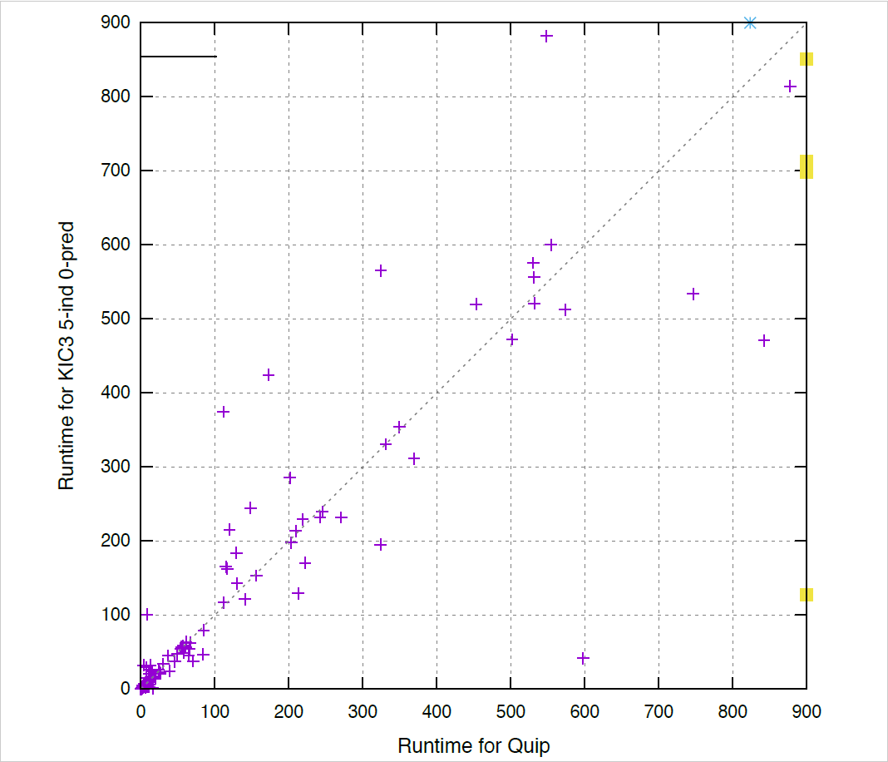
Experimental Results
Increasing k, while fixing m=0:
Slightly in favor of using k-induction
Runtimes are highly correlated
The scatter plot has k=5 and m=0
Points above diagonal = wins for IC3
Points below diagonal = wins for KIC3
IC3 solves 230 properties in 52,776 s
KIC3 solves 233 properties in 51,695 s
Similar observations on proprietary designs and larger time-limits
Notes:
This formulation allows to easily reuse invariants between targets, problems; treat multiple targets “concurrently”, and so on…

Slide 54
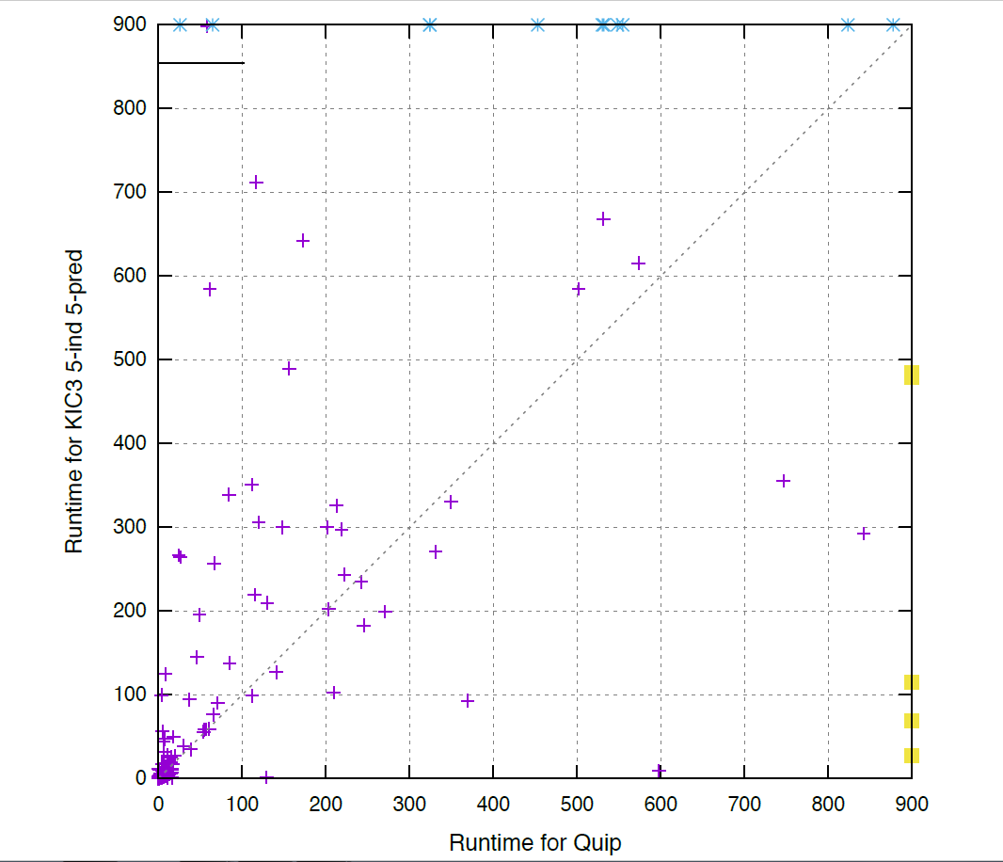
Experimental Results
Increasing m, while fixing k:
Significantly degrades performance
Runtimes are less correlated
The scatter plot has k=5 and m=5
Points above diagonal = wins for IC3
Points below diagonal = wins for KIC3
IC3 solves 230 properties in 52,776 s
KIC3 solves 224 properties in 57,864 s
Similar observations on proprietary designs and larger time-limits
Notes:
This formulation allows to easily reuse invariants between targets, problems; treat multiple targets “concurrently”, and so on…

Slide 55
Conclusion
IC3 is a great algorithm for hardware Model Checking
but, it can still be improved
QUIP: QUest for an Inductive Proof
aggressively push existing lemmas
enlarge initial state by computing reachable states
use reachable states to prune bad lemmas
KIC3: IC3 and k-induction
k-induction without unrolling (and without simple path constraints)
integrates easily into IC3 framework
expensive, hard to control when to apply
IC3 is a great framework to explore MC strategies

Slide 56

?
?
?
?
?
?

